Slide 1


Siddhi Shrivastava
October 17th, 2023

Slide 2

Outline
Executive Summary
Introduction
Methodology
Results
Conclusion
Appendix

Slide 3
Executive Summary
SpaceX advertises Falcon 9 rocket launches on its website, with a cost of 62 million dollars; other providers cost upward of 165 million dollars each, much of the savings is because SpaceX can reuse the first stage.
This information can be used by company Space Y to bid against SpaceX for a rocket launch.
In this project, I created a machine learning pipeline to predict if the first stage will land by extracting SpaceX launch details over the years.

Slide 4
Introduction
SpaceX advertises Falcon 9 rocket launches on its website, with a cost of 62 million dollars; other providers cost upward of 165 million dollars each, much of the savings is because SpaceX can reuse the first stage.
This information can be used by company Space Y to bid against SpaceX for a rocket launch.
In this project, I created a machine learning pipeline to predict if the first stage will land by extracting SpaceX launch details over the years.

Slide 5

Section 1

Slide 6
Methodology
Executive Summary
Data collection methodology:
Data collected through SpaceX API and webscraping.
Perform data wrangling
Cleaned the data, filled in missing values, and transformed training labels.
Perform exploratory data analysis (EDA) using visualization and SQL
Perform interactive visual analytics using Folium and Plotly Dash
Perform predictive analysis using classification models
Used various models to identify the best, i.e, Decision Tree Classifier.

Slide 7
Data Collection
SpaceX API
Webscraping
Web scrap falcon 9 launch records with Beautiful soup
Send request to Spacex API
Extract a Falcon 9 launch records HTML table from Wikipedia
Collect json file
Convert to pandas dataframe
Parse the table and convert it into a Pandas data frame

Slide 8
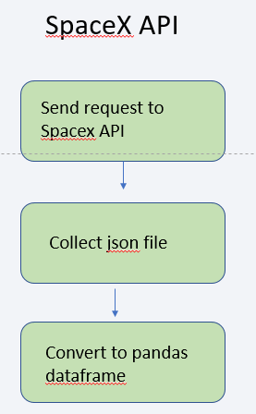
Data Collection – SpaceX API
GitHub repository link:
https://github.com/DjangoMustang/Falcon9/blob/main/Data%20Collection%20API.ipynb?short_path=2778005

Slide 9
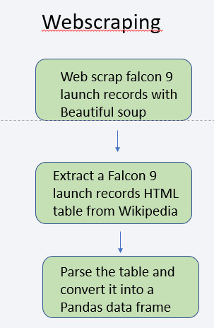
Data Collection - Scraping
GitHub repository link:
https://github.com/DjangoMustang/Falcon9/blob/main/Data%20Wrangling.ipynb?short_path=baec9f4

Slide 10
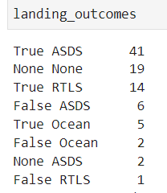
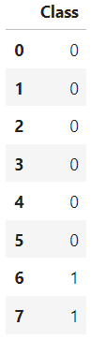
Data Wrangling
Created a landing outcome label from Outcome column.
landing_class = 0 bad_outcome
landing_class = 1 otherwise
GitHub repository link:
https://github.com/DjangoMustang/Falcon9/blob/main/Data%20Wrangling.ipynb?short_path=baec9f4

Slide 11
EDA with Data Visualization
Used the Seaborn library primarily to visualize data.
Use of Catplot to visualize the relationship between categorical and numerical variables.
Use of Scatterplot to visualize the relationship among numerical variables.
Use of Bar charts to visualize Success Rate by Orbit Type.
GitHub repository link:
https://github.com/DjangoMustang/Falcon9/blob/main/EDA%20with%20Data%20Vizualization.ipynb?short_path=ca34f69

Slide 12
EDA with SQL
Loaded the data in the Db2 database and performed queries using sqlalchemy.
Total 101 records of Falcon 9 launches.
From four distinct launch sites.
Total payload mass carried by boosters launched by NASA (CRS) = 45596 kg.
Average payload mass carried by booster version F9 v1.1 = 2534.67 kg.
The first successful landing outcome in the ground pad was achieved on 22nd Dec 2015.
Successful outcomes = 61 and failures = 10
Several booster versions have carried the maximum payload mass of 15600 kg.
GitHub link:
https://github.com/DjangoMustang/Falcon9/blob/main/EDA%20with%20SQL.ipynb?short_path=b2ceb09

Slide 13
Build an Interactive Map with Folium
Marked all launch sites on a map using folium.Circle and labele with folium.marker.
Calculated the distances between a launch site to its proximities from city, railways, roadways, coatline and labeled them.
GitHub URL:
https://github.com/DjangoMustang/Falcon9/blob/main/Folium.ipynb?short_path=27837d5

Slide 14
Build a Dashboard with Plotly Dash
Plotted a Pie chart to visualize the share of launches from each site and the number of successful and unsuccessful launches among those.
Created a scatterplot to visualize the correlation between Payload and Success for all sites.
GitHub link:
https://github.com/DjangoMustang/Falcon9/blob/main/Plotly.ipynb?short_path=27837d5

Slide 15
Predictive Analysis (Classification)
Standardized the data using StandardScaler.
Split the data into training and test sets.
Algorithms used:
Logistic regression
Support Vector Machine
Decision Tree Classifier
KNN
Found the best performing algorithm to be Decision Tree using GridSearchCV, accuracy socre and confusion matrix.
GitHub link:
https://github.com/DjangoMustang/Falcon9/blob/main/Predictive%20Analysis.ipynb?short_path=e8e96cb

Slide 16
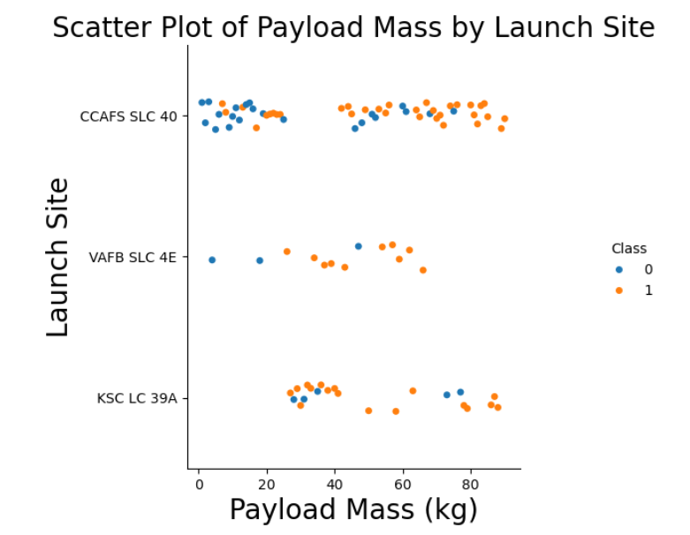
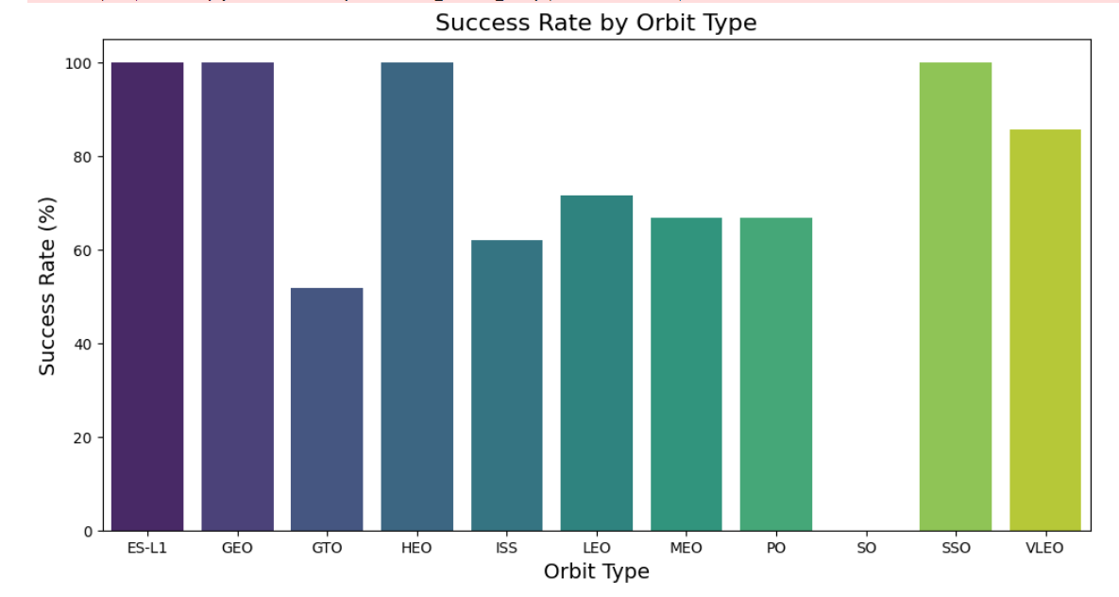
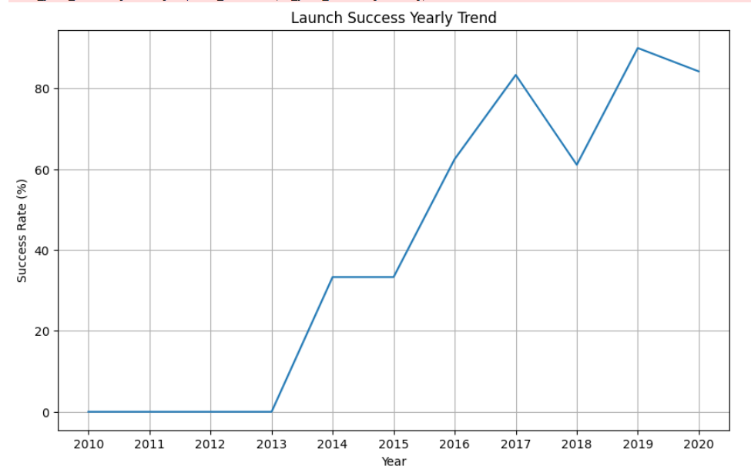
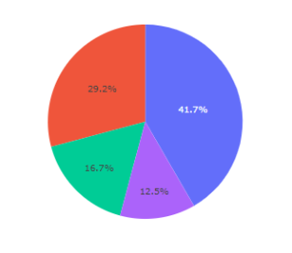
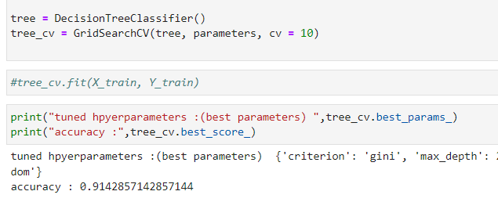
Results

Slide 17

Section 2

Slide 18
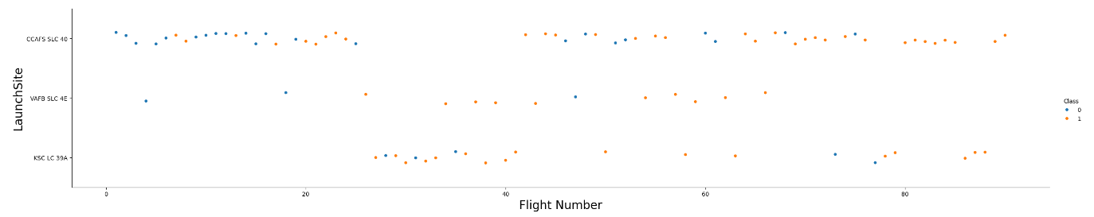
Flight Number vs. Launch Site
Different launch sites have different success rates. CCAFS LC-40,
has a success rate of 60 %, while KSC LC-39A and VAFB SLC 4E has a success rate of 77%.

Slide 19
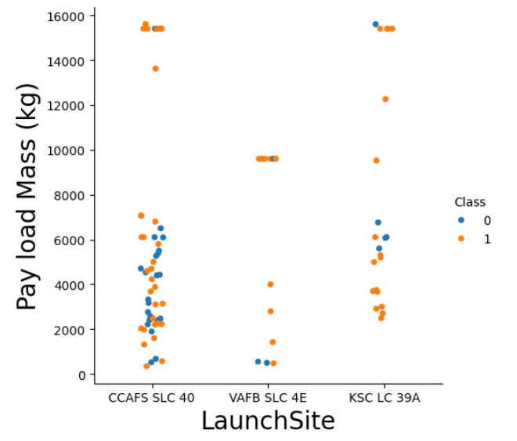
Payload vs. Launch Site
In VAFB-SLC launch site there are no rockets launched for heavy payload mass(greater than 10000.

Slide 20
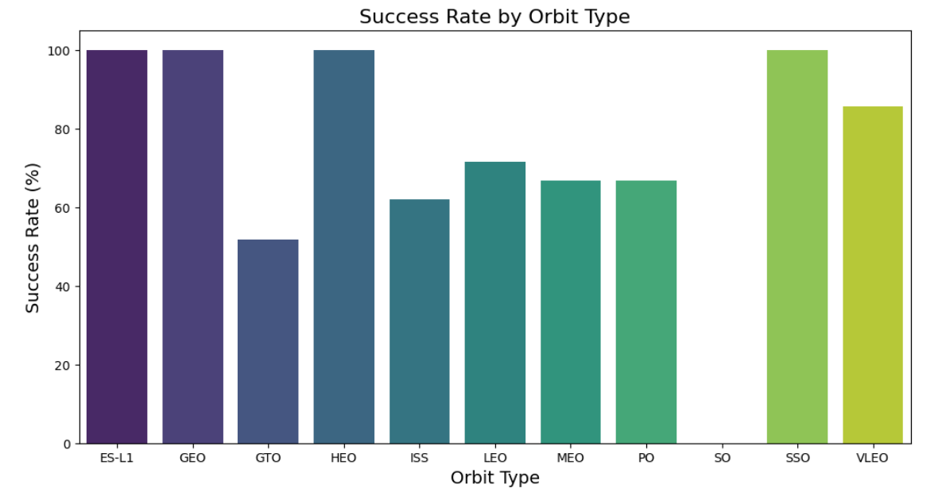
Success Rate vs. Orbit Type
100% success in ES-L1,
GEO, SSO, and HEO.

Slide 21
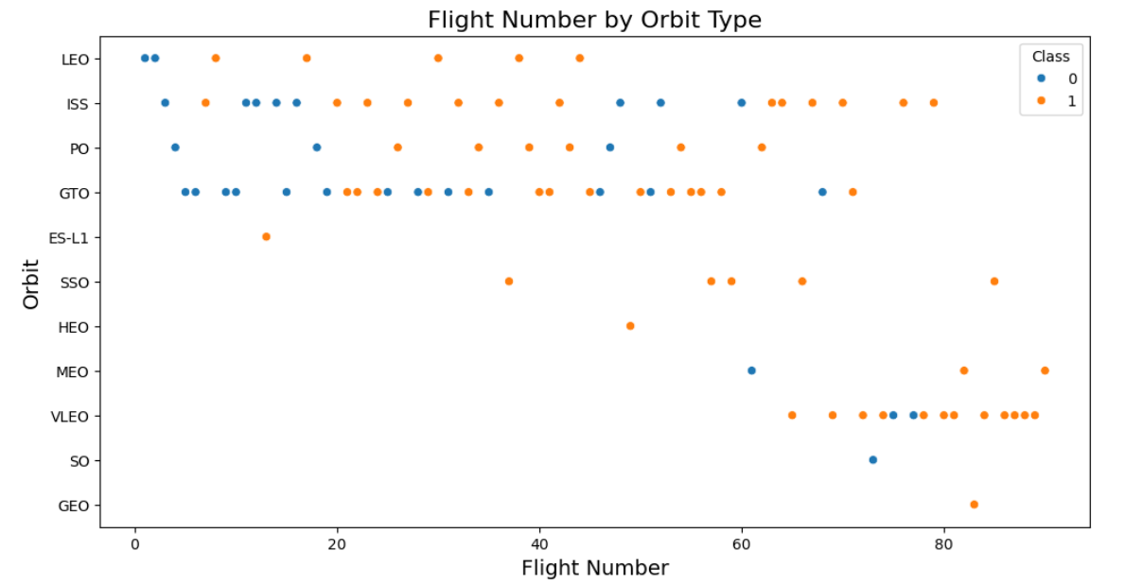
Flight Number vs. Orbit Type
LEO orbit the Success appears related to the number of flights; on the other hand, there seems to be no relationship between flight number when in GTO orbit.

Slide 22
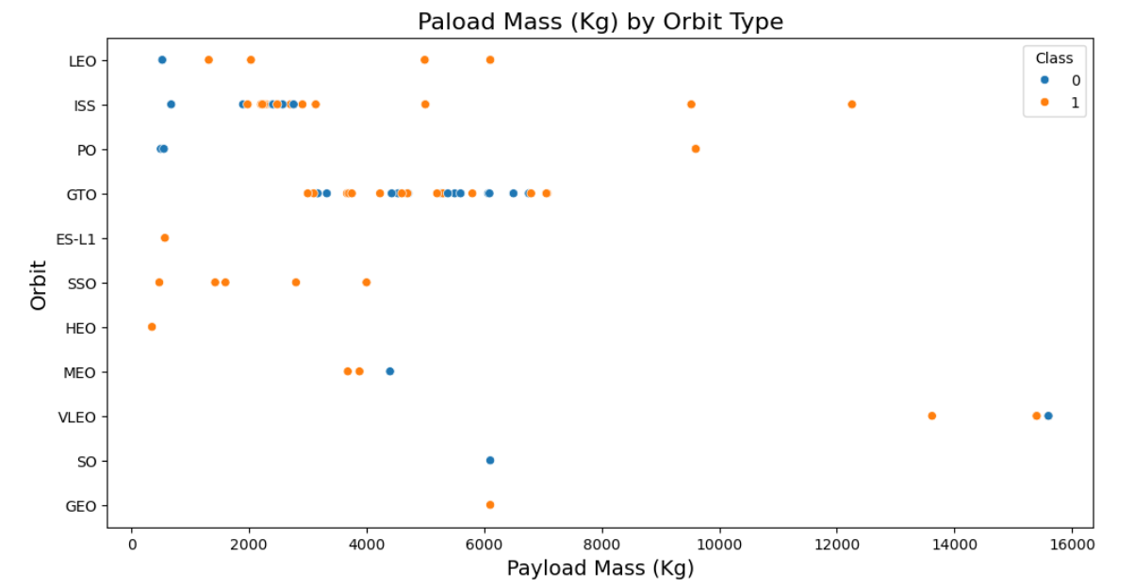
Payload vs. Orbit Type
With heavy payloads the successful landing or positive landing rate are more for Polar,LEO and ISS.
However for GTO we cannot distinguish this well as both positive landing rate and negative landing(unsuccessful mission) are both there here.

Slide 23
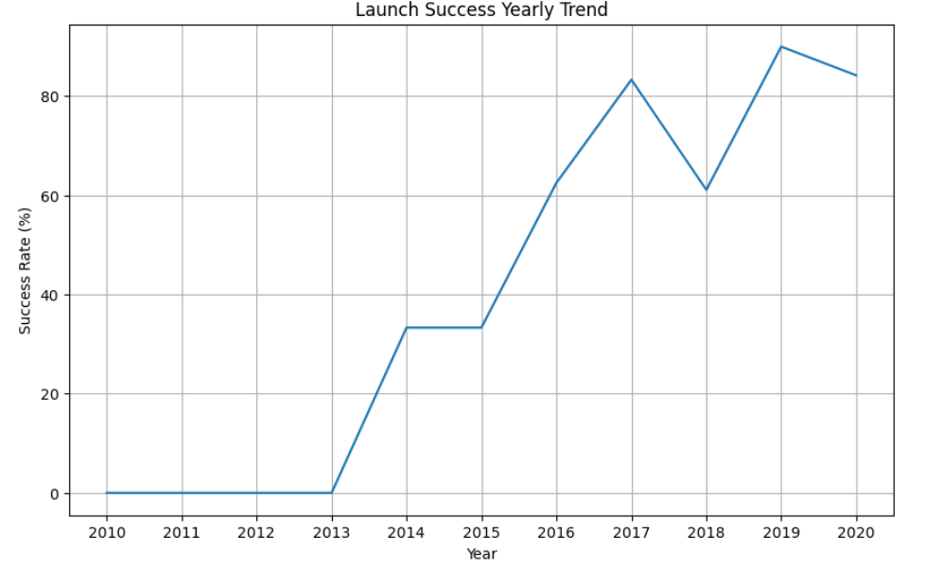
Launch Success Yearly Trend
The success rate since 2013 kept increasing till 2020

Slide 24
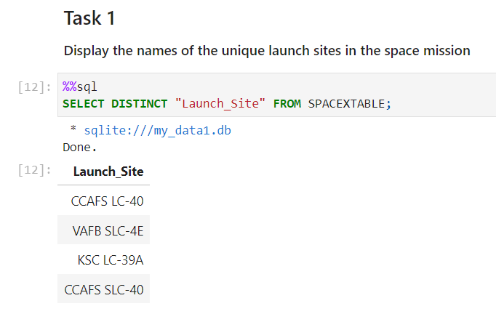
All Launch Site Names

Slide 25
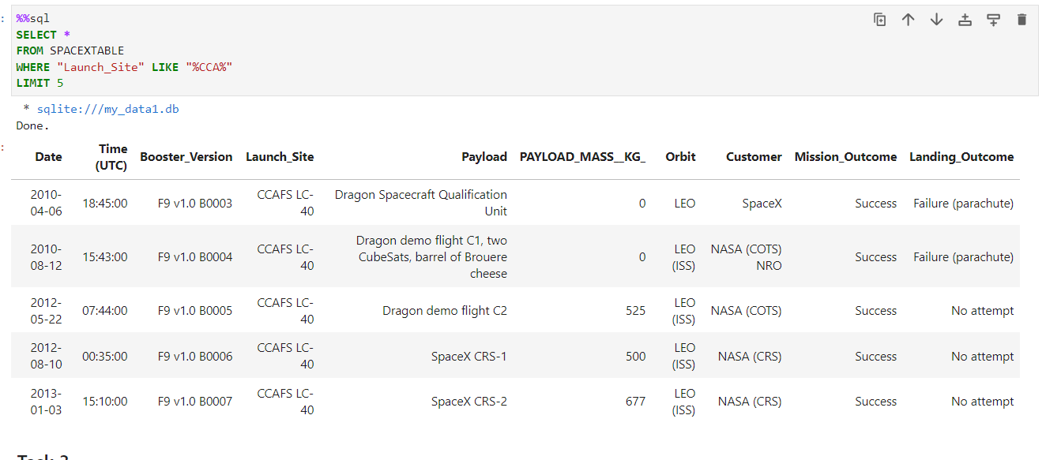
Launch Site Names Begin with 'CCA'

Slide 26
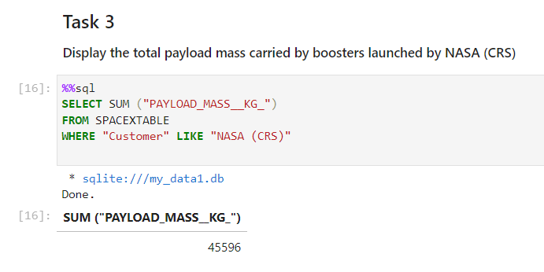
Total Payload Mass

Slide 27
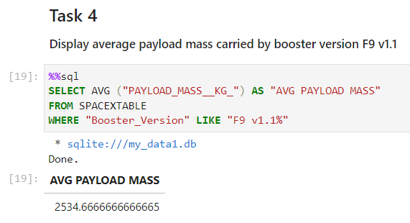
Average Payload Mass by F9 v1.1

Slide 28
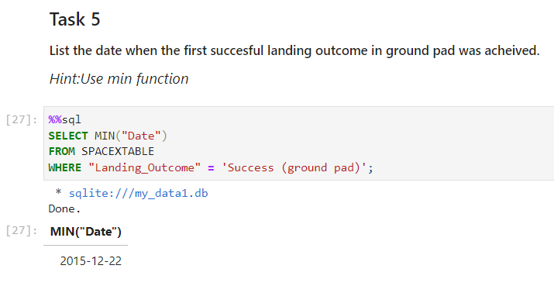
First Successful Ground Landing Date

Slide 29
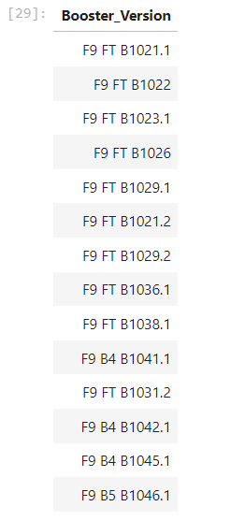
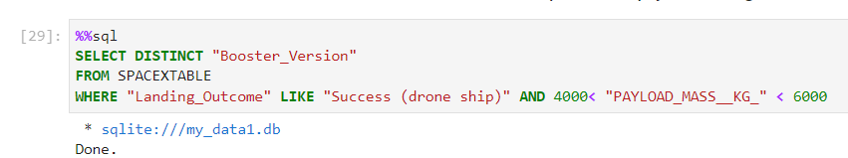
Successful Drone Ship Landing with Payload between 4000 and 6000

Slide 30
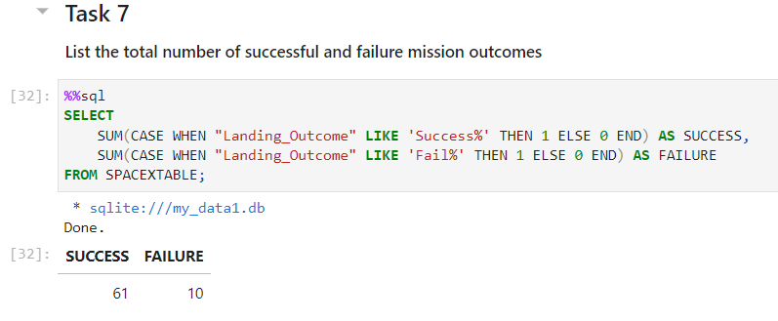
Total Number of Successful and Failure Mission Outcomes

Slide 31
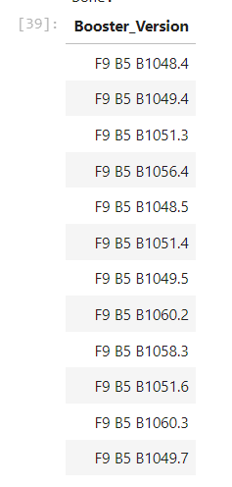
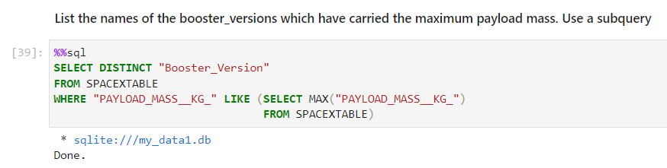
Boosters Carried Maximum Payload

Slide 32
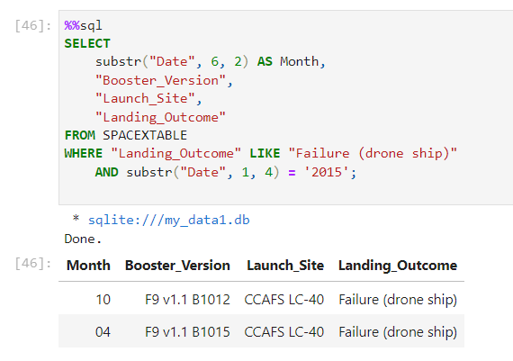
2015 Launch Records

Slide 33
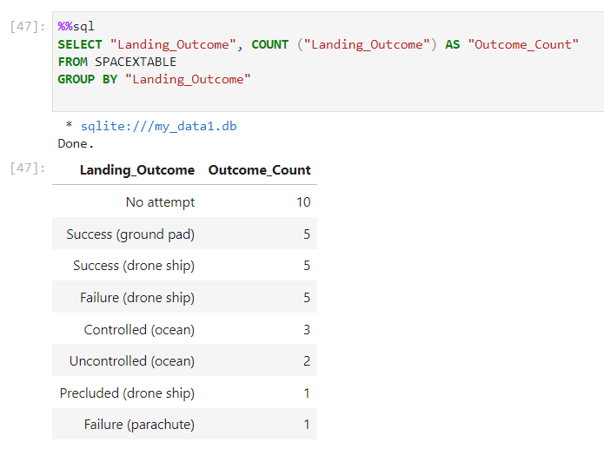
Rank Landing Outcomes Between 2010-06-04 and 2017-03-20

Slide 34

Section 3

Slide 35
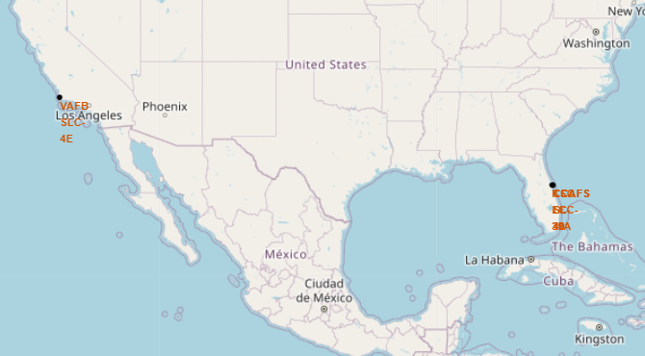
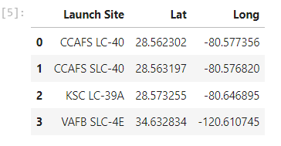
All Launch Sites
Location of the launch sites:

Slide 36
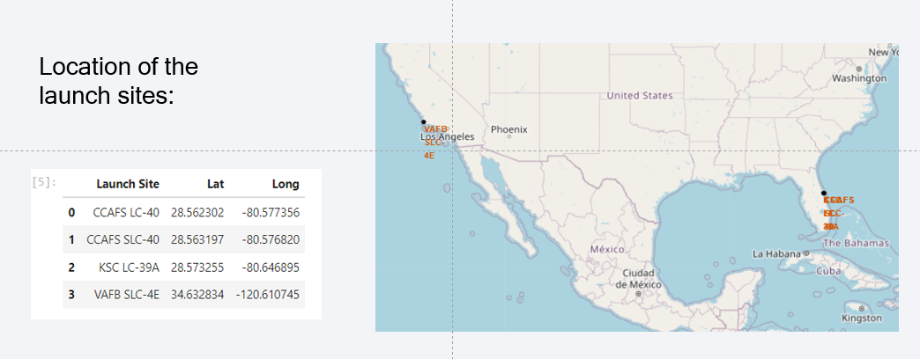
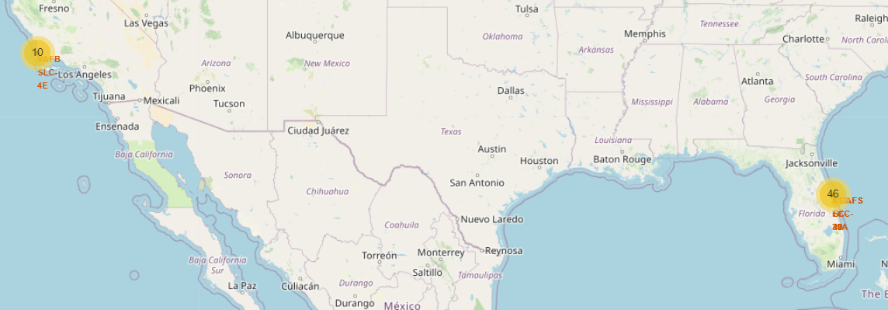
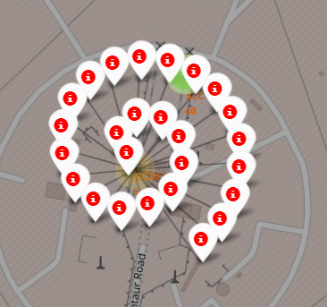
All Launch Sites; yellow color labeled

Slide 37
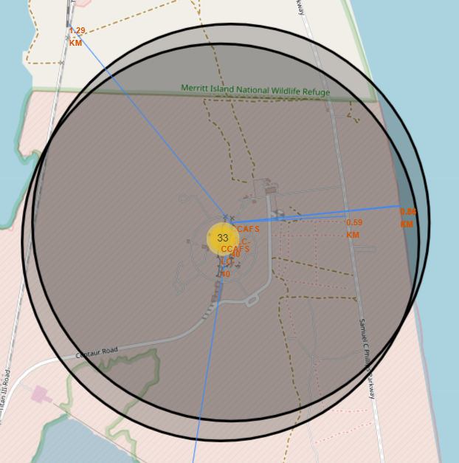
Distance between a CCAFS SLC 40 site to its proximities
The proximity of CCAFS SLC 40 to
Highway: 0.6km
Coastline:0.86km
Railways: 1.3km
City: 19.2km (Cape Canaveral city)
Overall, the findings suggest that launch sites are strategically located with good access to highways for transportation of equipment, close proximity to coastlines for safety, and relatively close to railways. The distance from populated cities is typically significant to ensure the safety of nearby communities.

Slide 38

Section 4

Slide 39
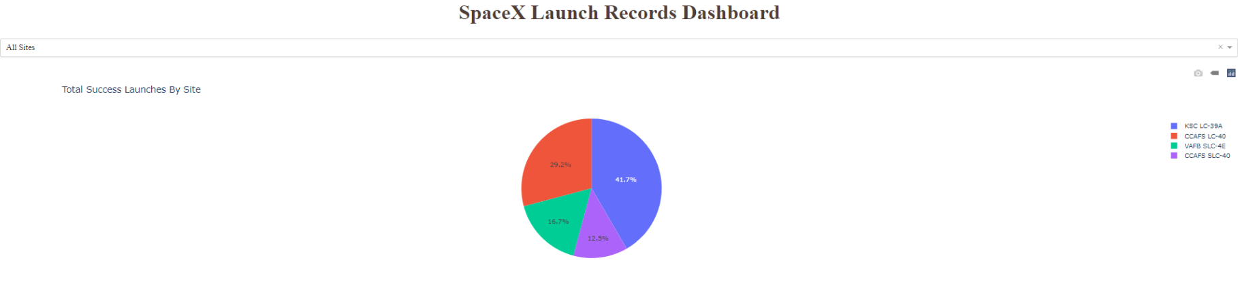
Plotly SpaceX launch Pie chart for success by site
KSC LC 39 A had the maximum success with 41%.

Slide 40
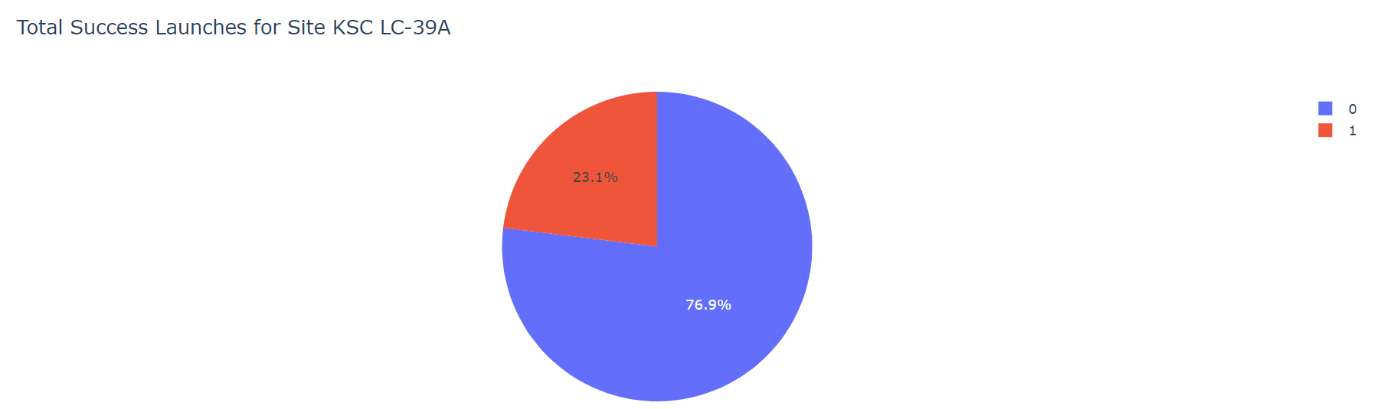
Success ration for KSC LC 39A
Success: 76.9%
Failure: 23.1%

Slide 41
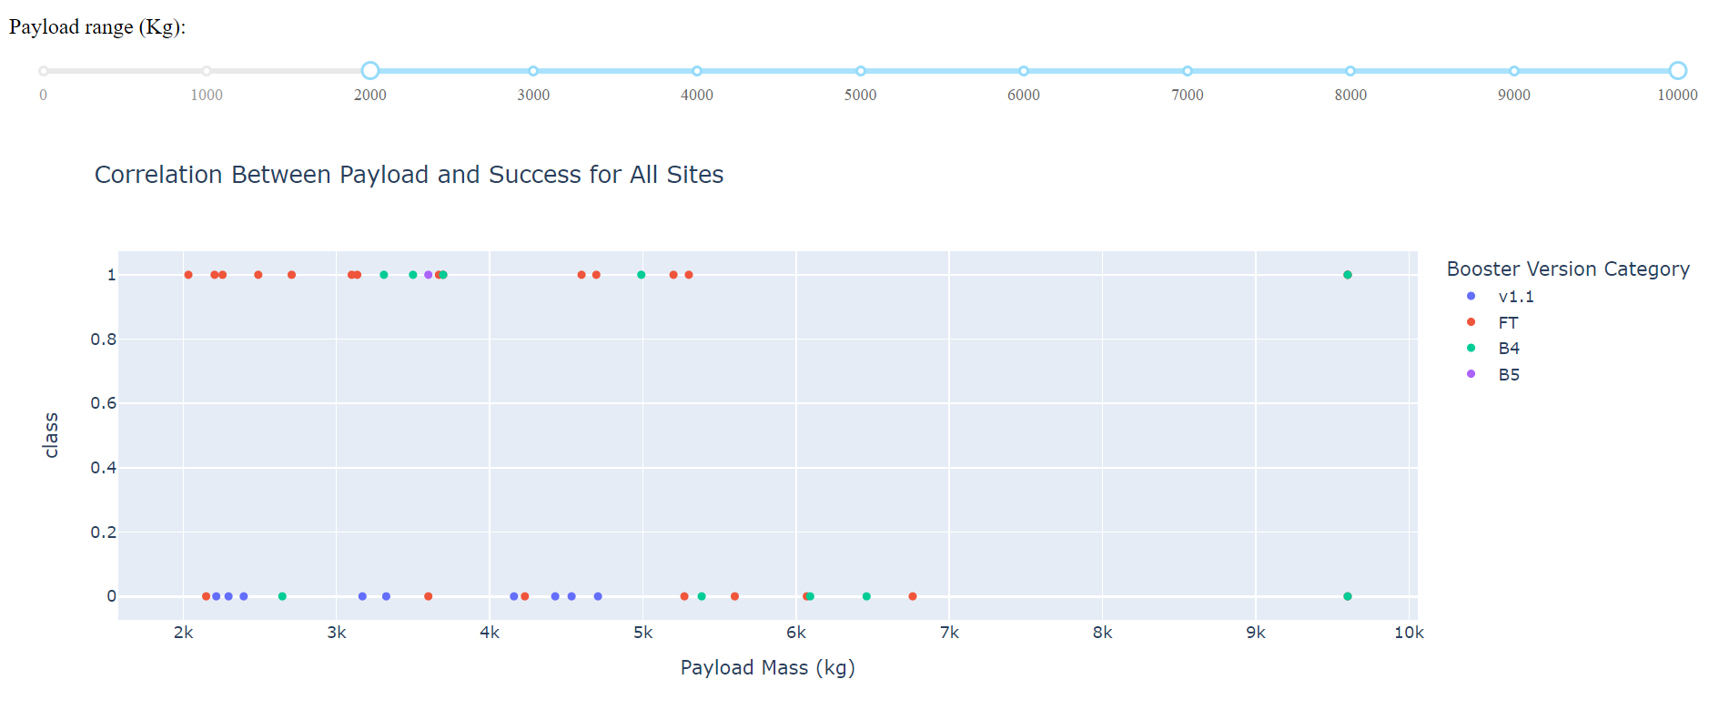
Correlation between Payload and Success for All sites
By Booster Version
• Payloads between 2,000 kg and 5,000 kg have the highest success rate
• 1 indicating successful outcome and 0 indicating an unsuccessful outcome

Slide 42

Section 5

Slide 43
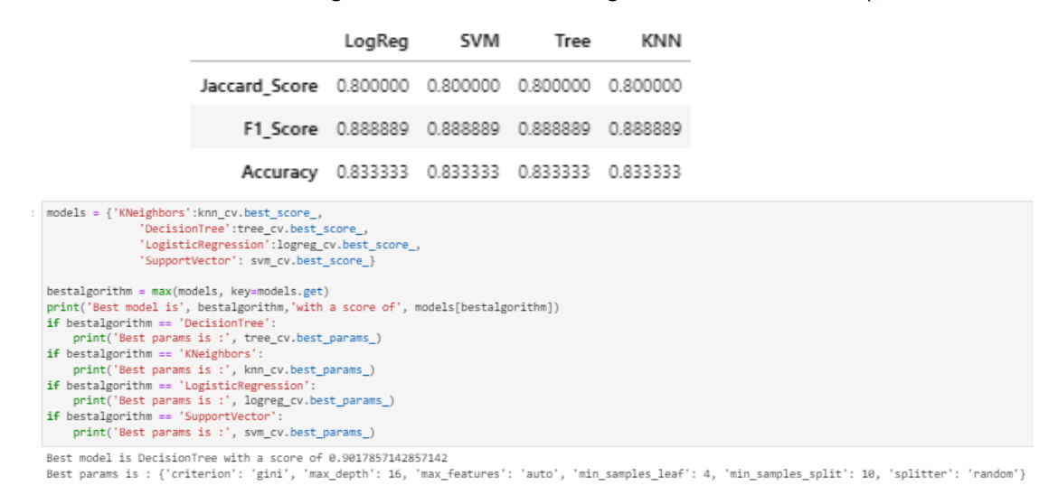
Classification Accuracy
All the models performed at about the same level and had the same scores and accuracy. This is likely due to the small dataset. The Decision Tree model slightly outperformed the rest when looking at .best_score_
best_score_ is the average of all cv folds for a single combination of the parameters.

Slide 44
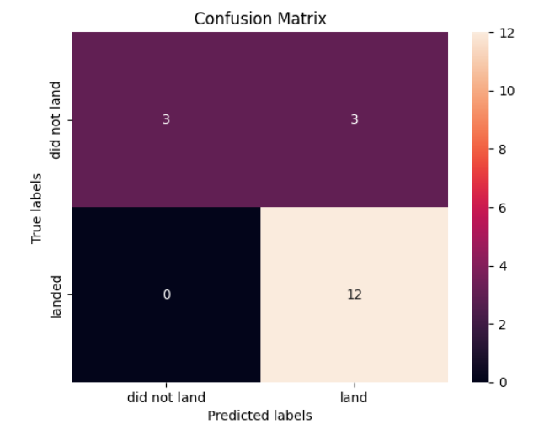
Confusion Matrix
All the confusion matrices were identical
The fact that there are false positives (Type 1 error) is not good

Slide 45
Conclusions
Model Performance: The test results indicate that the models exhibited similar performance, with a slight advantage in favor of the decision tree model.
Equator Proximity: Most of the launch sites are situated in close proximity to the equator, benefiting from the Earth's rotational speed, which reduces the cost of additional fuel and boosters.
Coastal Locations: All of the launch sites are positioned near the coast.
Launch Success Rate Improvement: Over time, the success rate of launches has demonstrated an increasing trend.
KSC LC-39A: KSC LC-39A stands out with the highest success rate among launch sites. It achieves a 100% success rate for launches with payloads under 5,500 kg.
Orbits: ES-L1, GEO, HEO, and SSO orbits have consistently achieved a 100% success rate.
Payload Mass Impact: Across all launch sites, there is a positive correlation between the payload mass (measured in kilograms) and the likelihood of mission success.

Slide 46
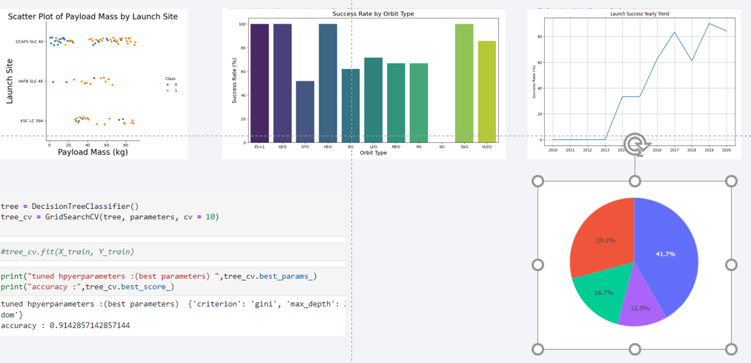
Appendix

Slide 47


